Slide 1
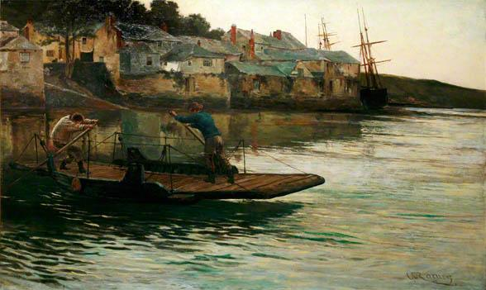
Bodinnick Ferry

Slide 2
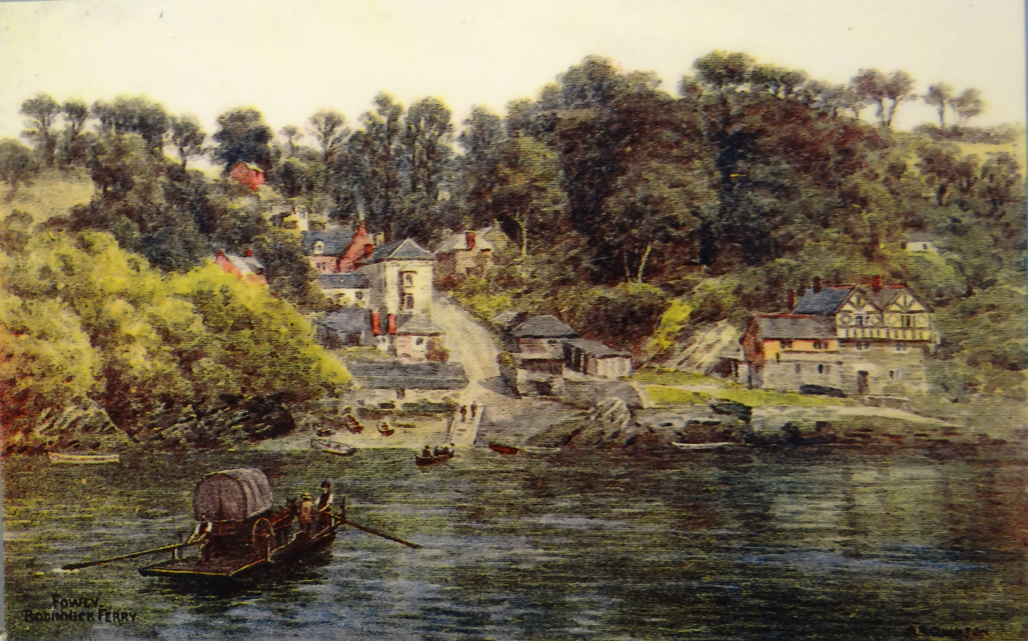

Slide 3
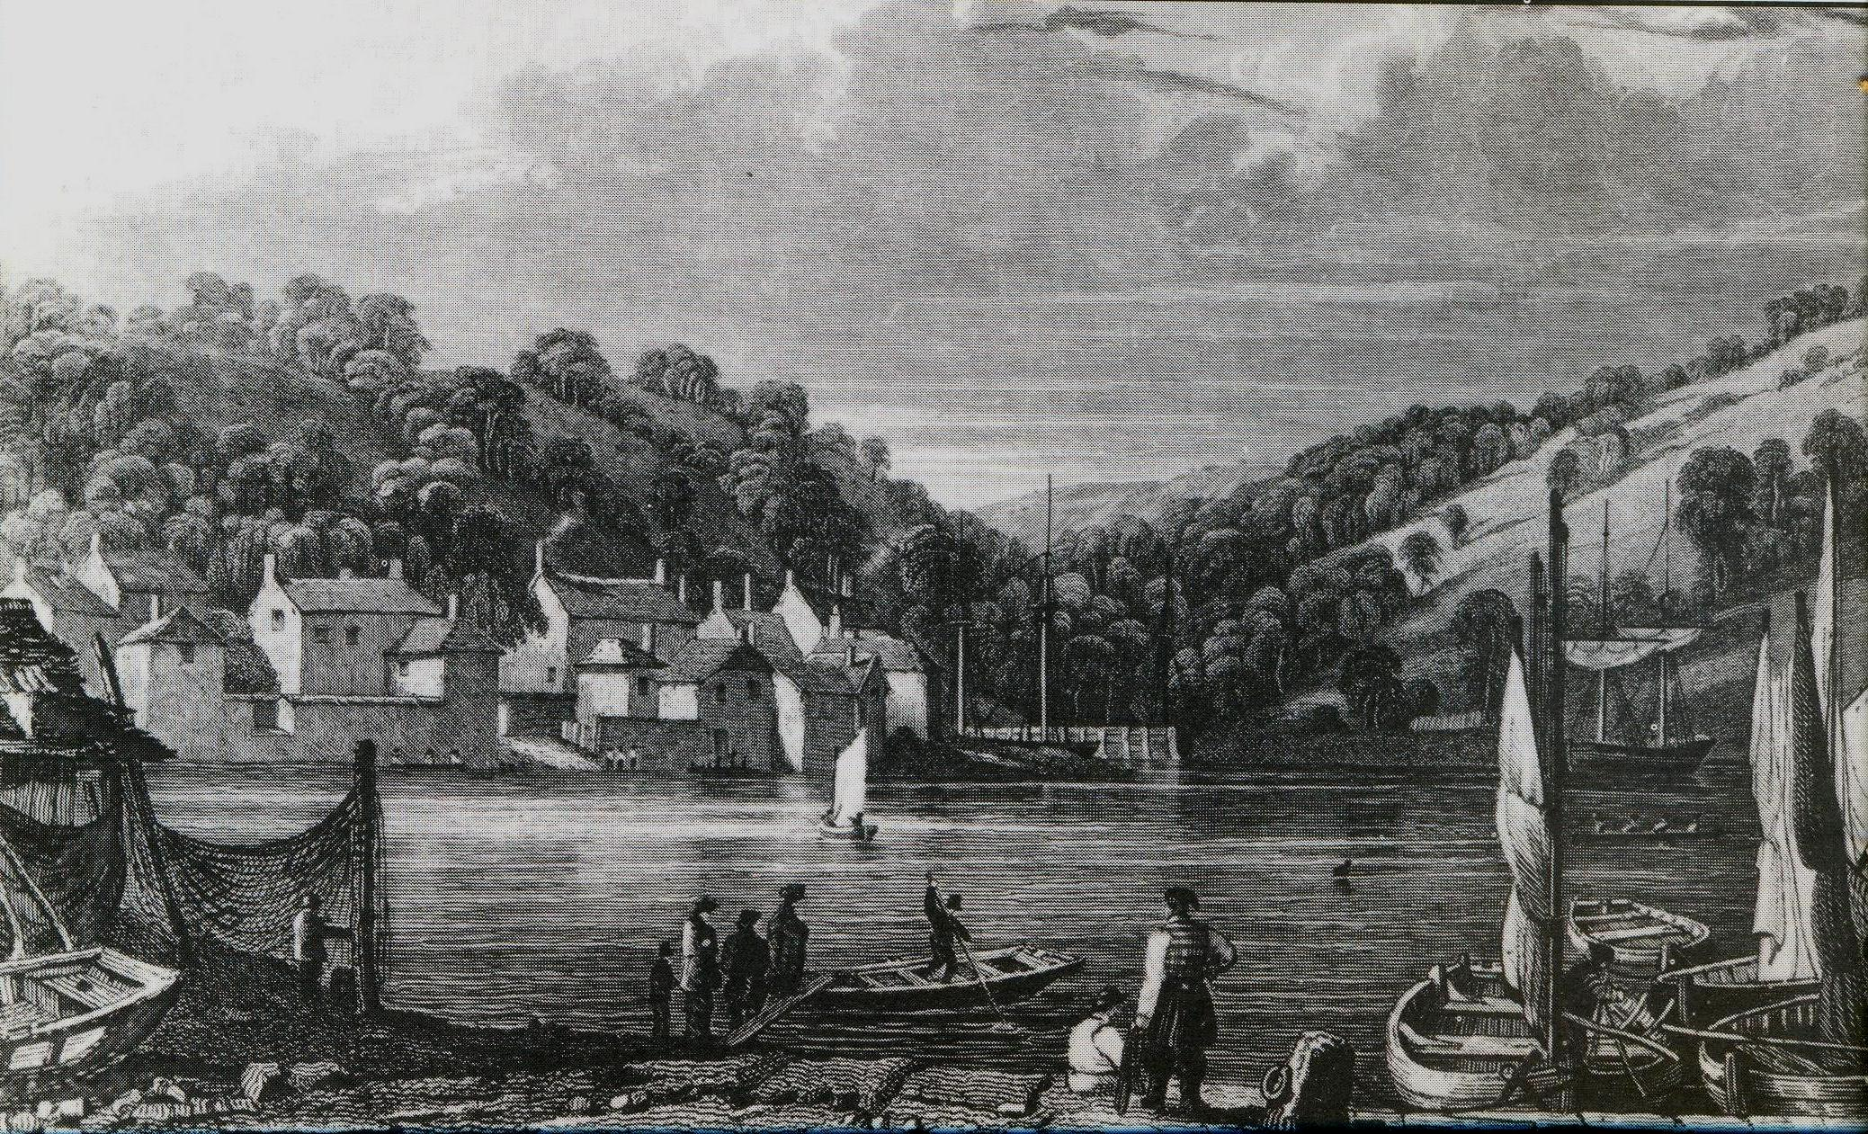
Bodinnick Ferry from Caffa Mill 1831

Slide 4
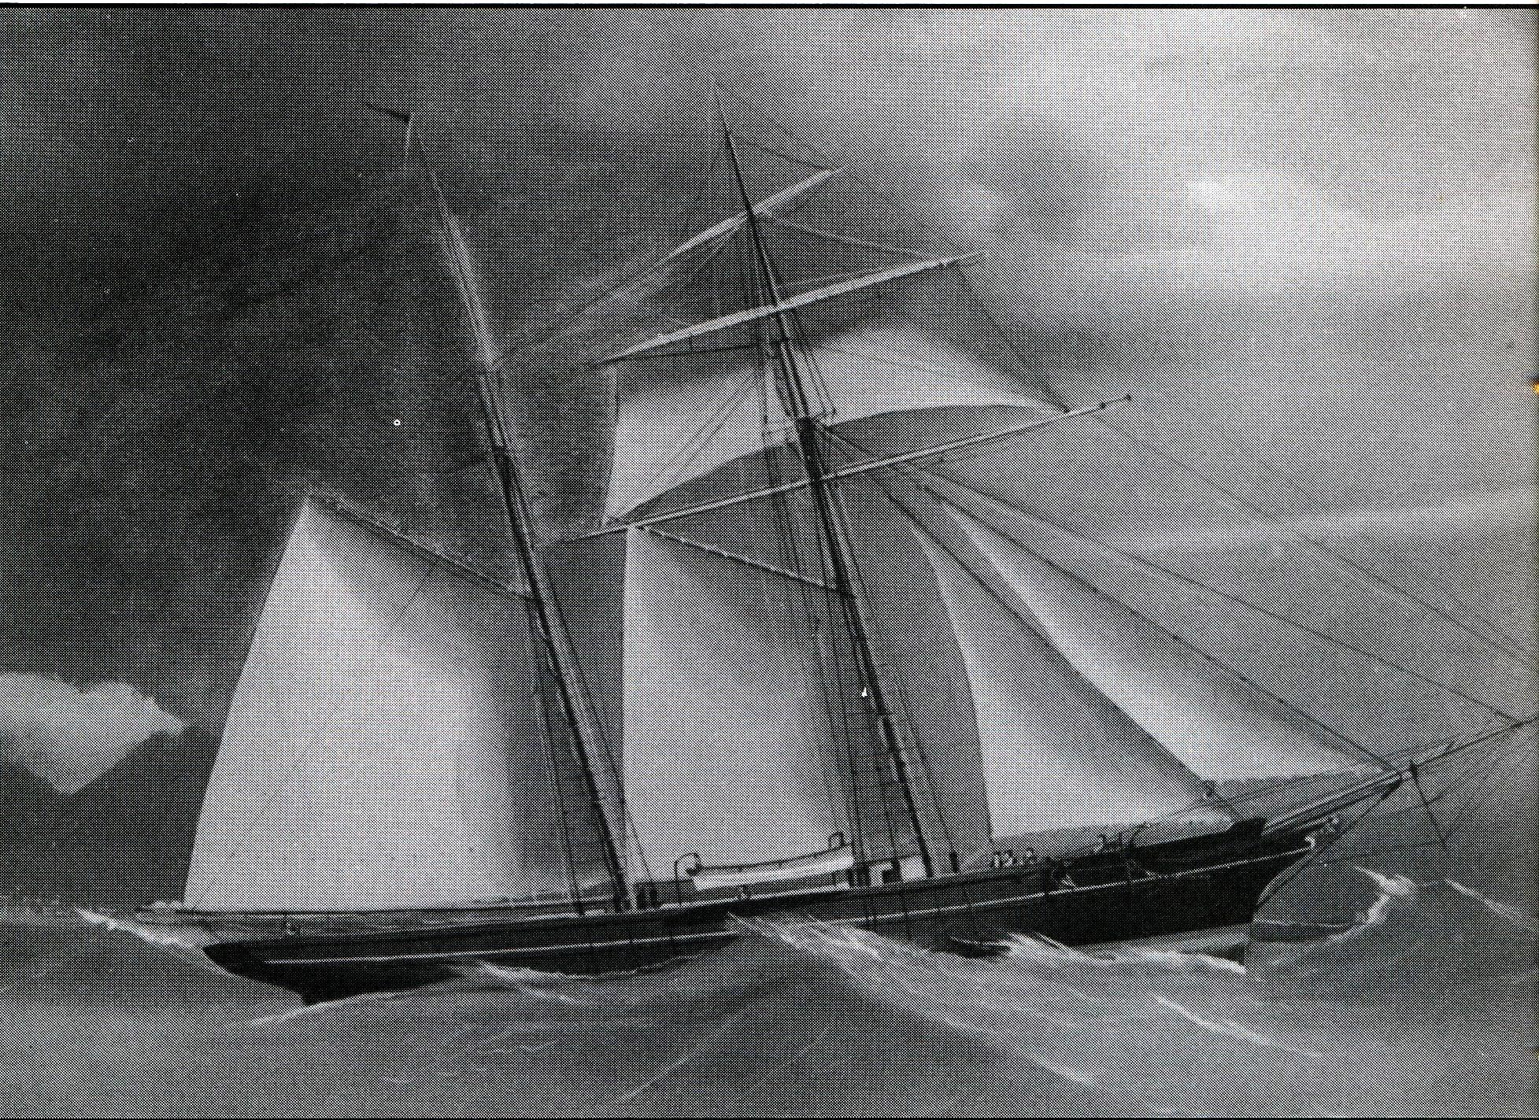
“Rippling Wave” Schooner- 1869

Slide 5
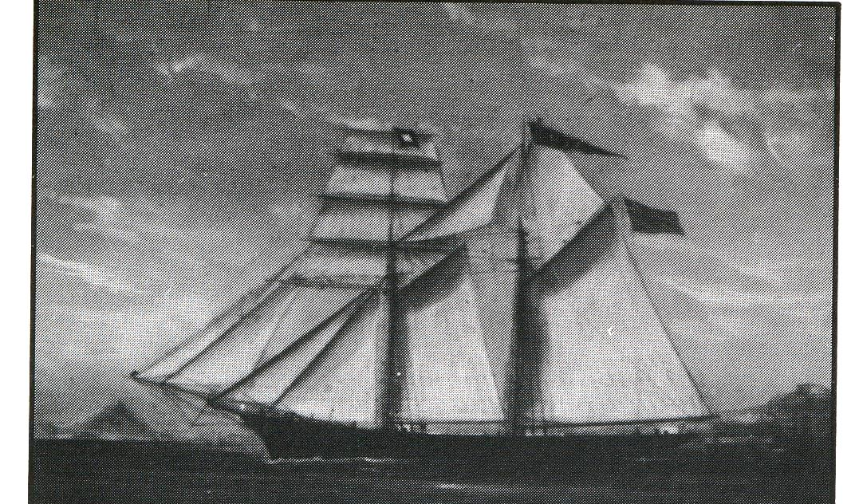
“Thetis” – Schooner 1873

Slide 6
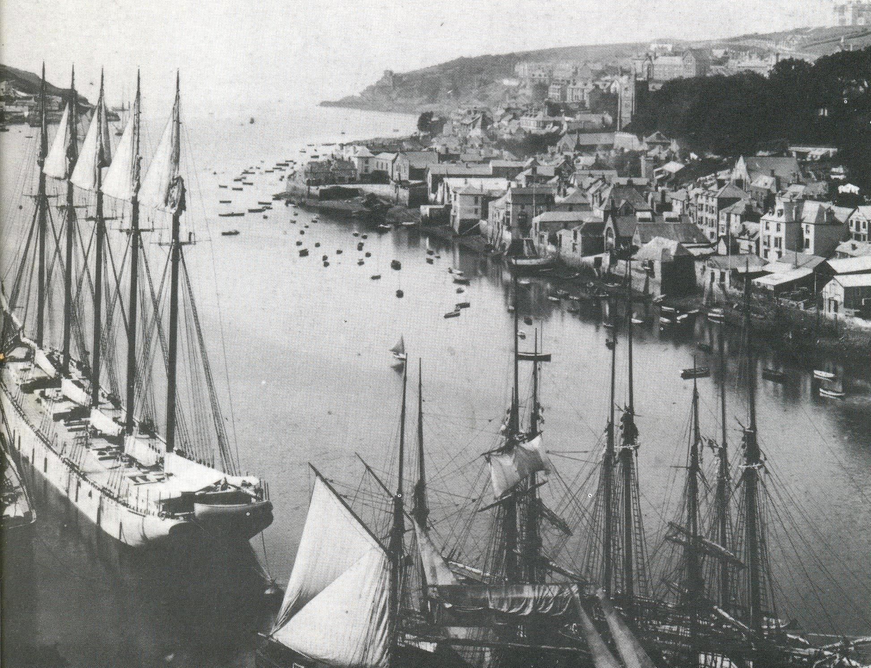
Fowey Harbour 1901

Slide 7
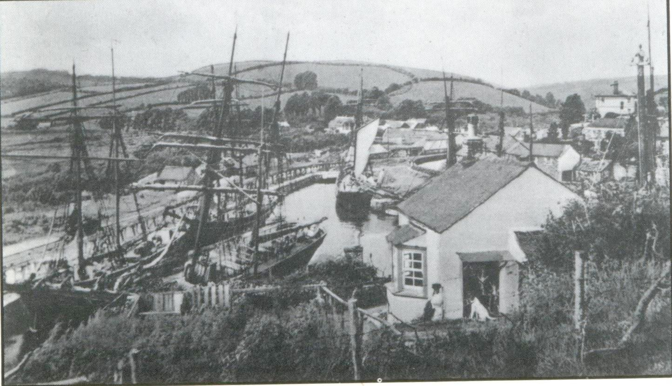
Pentewan Harbour about 1900

Slide 8
Mevagissey early 1900’s

Slide 9
Mevagissey early 1900’s

Slide 10
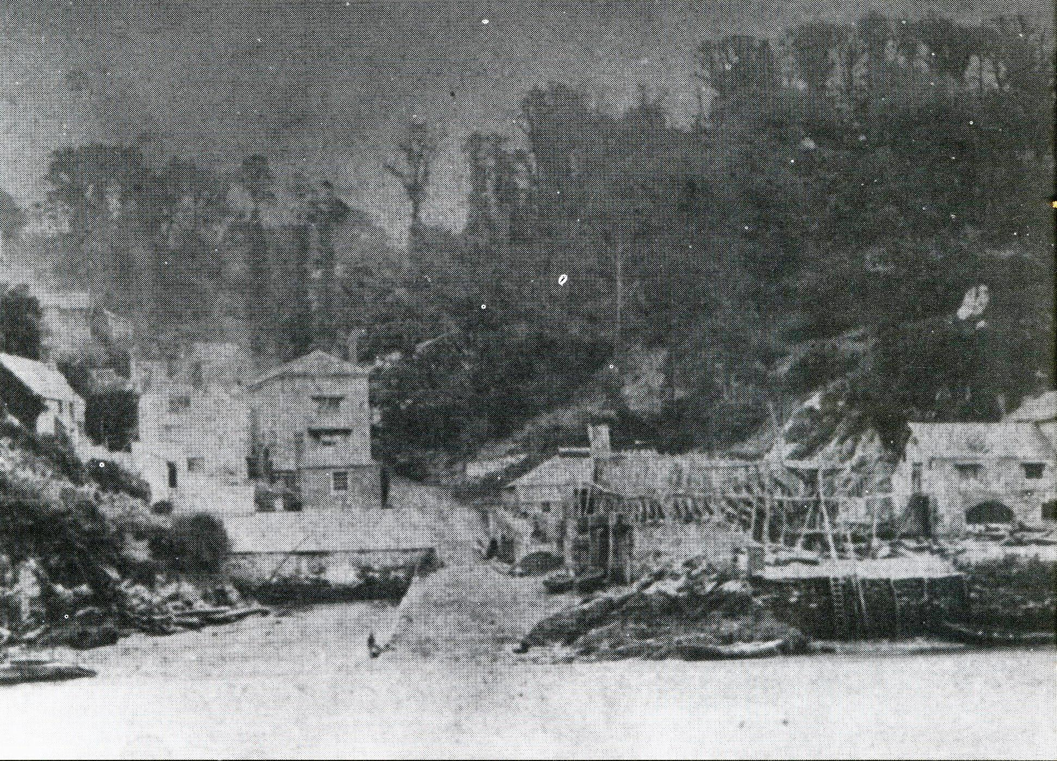

Slide 11
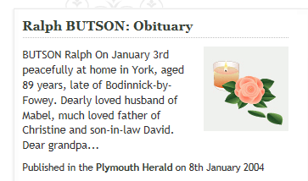

Slide 12
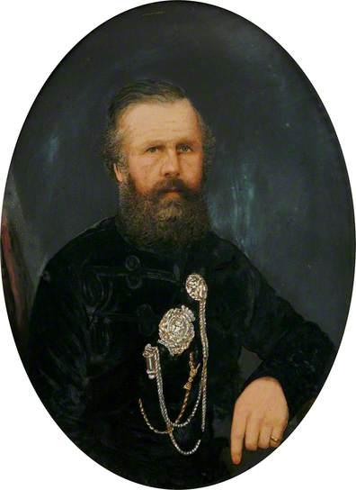
Garibaldi's Englishman (Colonel John Whitehead Peard) (1811–1880)

Slide 13
PEARD, JOHN WHITEHEAD (1811–1880), ‘Garibaldi's Englishman,’ born at Fowey, Cornwall, in July 1811, was the second son of Vice-admiral Shuldham Peard [q. v.], by his second wife, Matilda, daughter of William Fortescue of Penwarne. He was educated at the King's School, Ottery St. Mary, Devonshire, and at Exeter College, Oxford, where he matriculated 4 March 1829, and graduated B.A. 2 May 1833, M.A. 17 Nov. 1836. A youth of ‘great stature and extraordinary muscular strength,’ who when but nineteen years of age weighed fourteen stone, he was described by an old waterman at Oxford as possessing ‘the shoulders of a bull.’ As stroke of the college boat, he was famous on the river, and during the town-and-gown rows of his undergraduate days his height and skill in boxing made him an object of terror to the roughs (Tupper, My Life as an Author, p. 61). In 1837 he became a barrister-at-law of the Inner Temple, being called on the same day with Sir F. H. Doyle, who describes his draining on a gaudy day in hall a loving-cup ‘which held about two quarts of spiced and sweetened wine.’ For some time he went the western circuit, but life at the bar must have been irksome to him, and down to 1859 he was a captain in the Duke of Cornwall's rangers. During his frequent visits to Italy he had been cut to the quick by the brutalities of the Neapolitan officials. He therefore joined the forces of Garibaldi, with whose aims he was in thorough sympathy, and, as a ‘splendid rifle-shot,’ organised and commanded a company of revolving-rifle soldiers, who gave him much trouble. When Garibaldi made his expedition to Sicily he was joined by Peard, who distinguished himself at the battle of Melazzo (20 July 1860), and at its conclusion was raised to the rank of colonel. He also accompanied the troops of Garibaldi on their advance to Naples, and commanded the English legion. For these services he received from Victor Emmanuel the cross of the order of Valour, and was known throughout England as ‘Garibaldi's Englishman’ (cf. West Briton, 9 Aug. p. 6).
On the retirement of Garibaldi to Caprera Peard returned to England, and when Garibaldi visited England he paid a visit to his old comrade at his seat of Penquite, on the Fowey river, 25–27 April 1864 (cf. Journals of Caroline Fox, 2nd edit. ii. 290–1, and Frederick Arnold, Reminiscences, ii. 9). Peard was a J.P. and D.L. for Cornwall, and he served the office of sheriff in 1869. He was also a prominent freemason, becoming P.G.M. of Cornwall 26 Aug. 1879. He died at Trenython, Par, 21 Nov. 1880, from the effects of a paralytic stroke, and was buried in Fowey cemetery on 24 Nov. He married at East Teignmouth, Devonshire, 7 June 1838, Catherine Augusta, daughter of the Rev. Dr. William Page Richards, formerly headmaster of Blundell's school, Tiverton. She survived him.
A portrait is in the ‘Illustrated London News,’ 11 Aug. 1860 (p. 135).

Slide 14
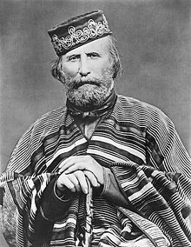

Slide 15
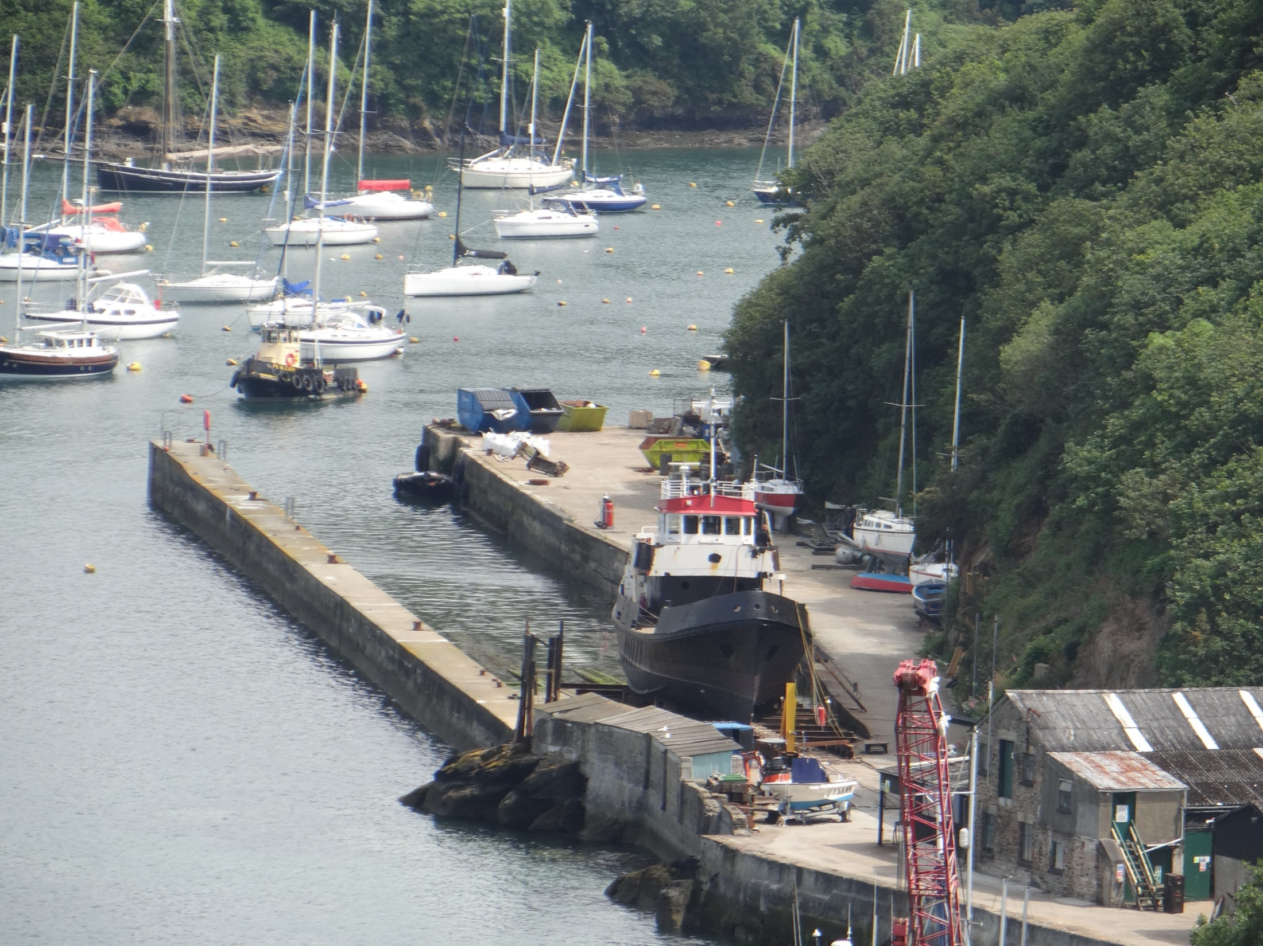

Slide 16
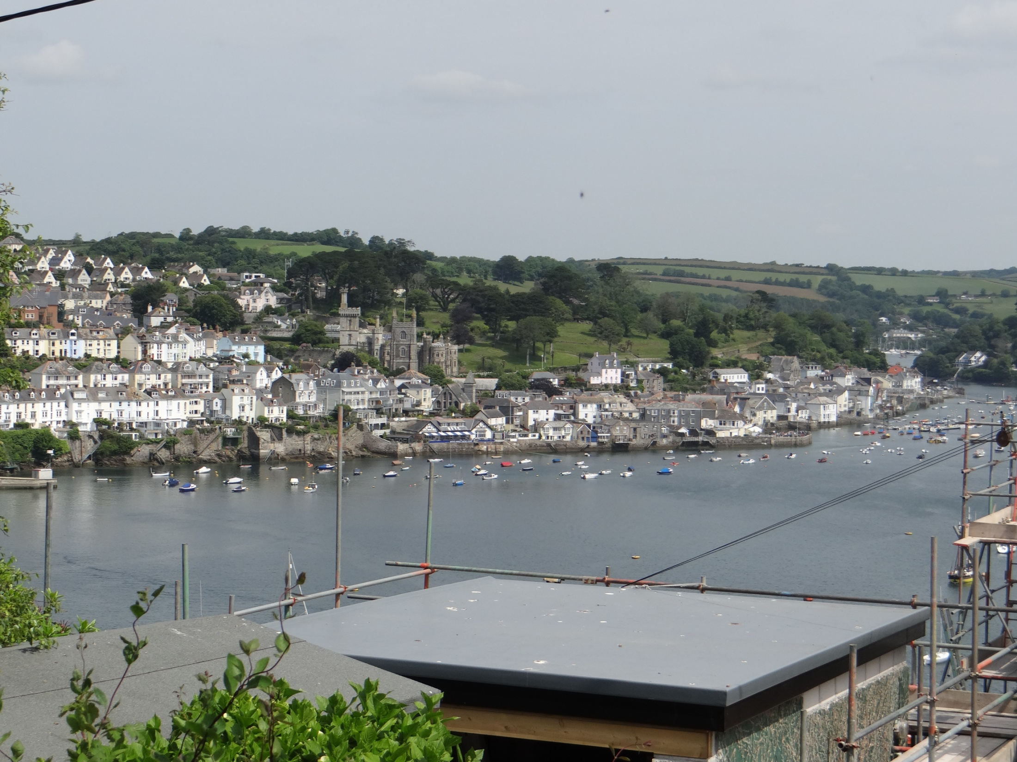

Slide 17
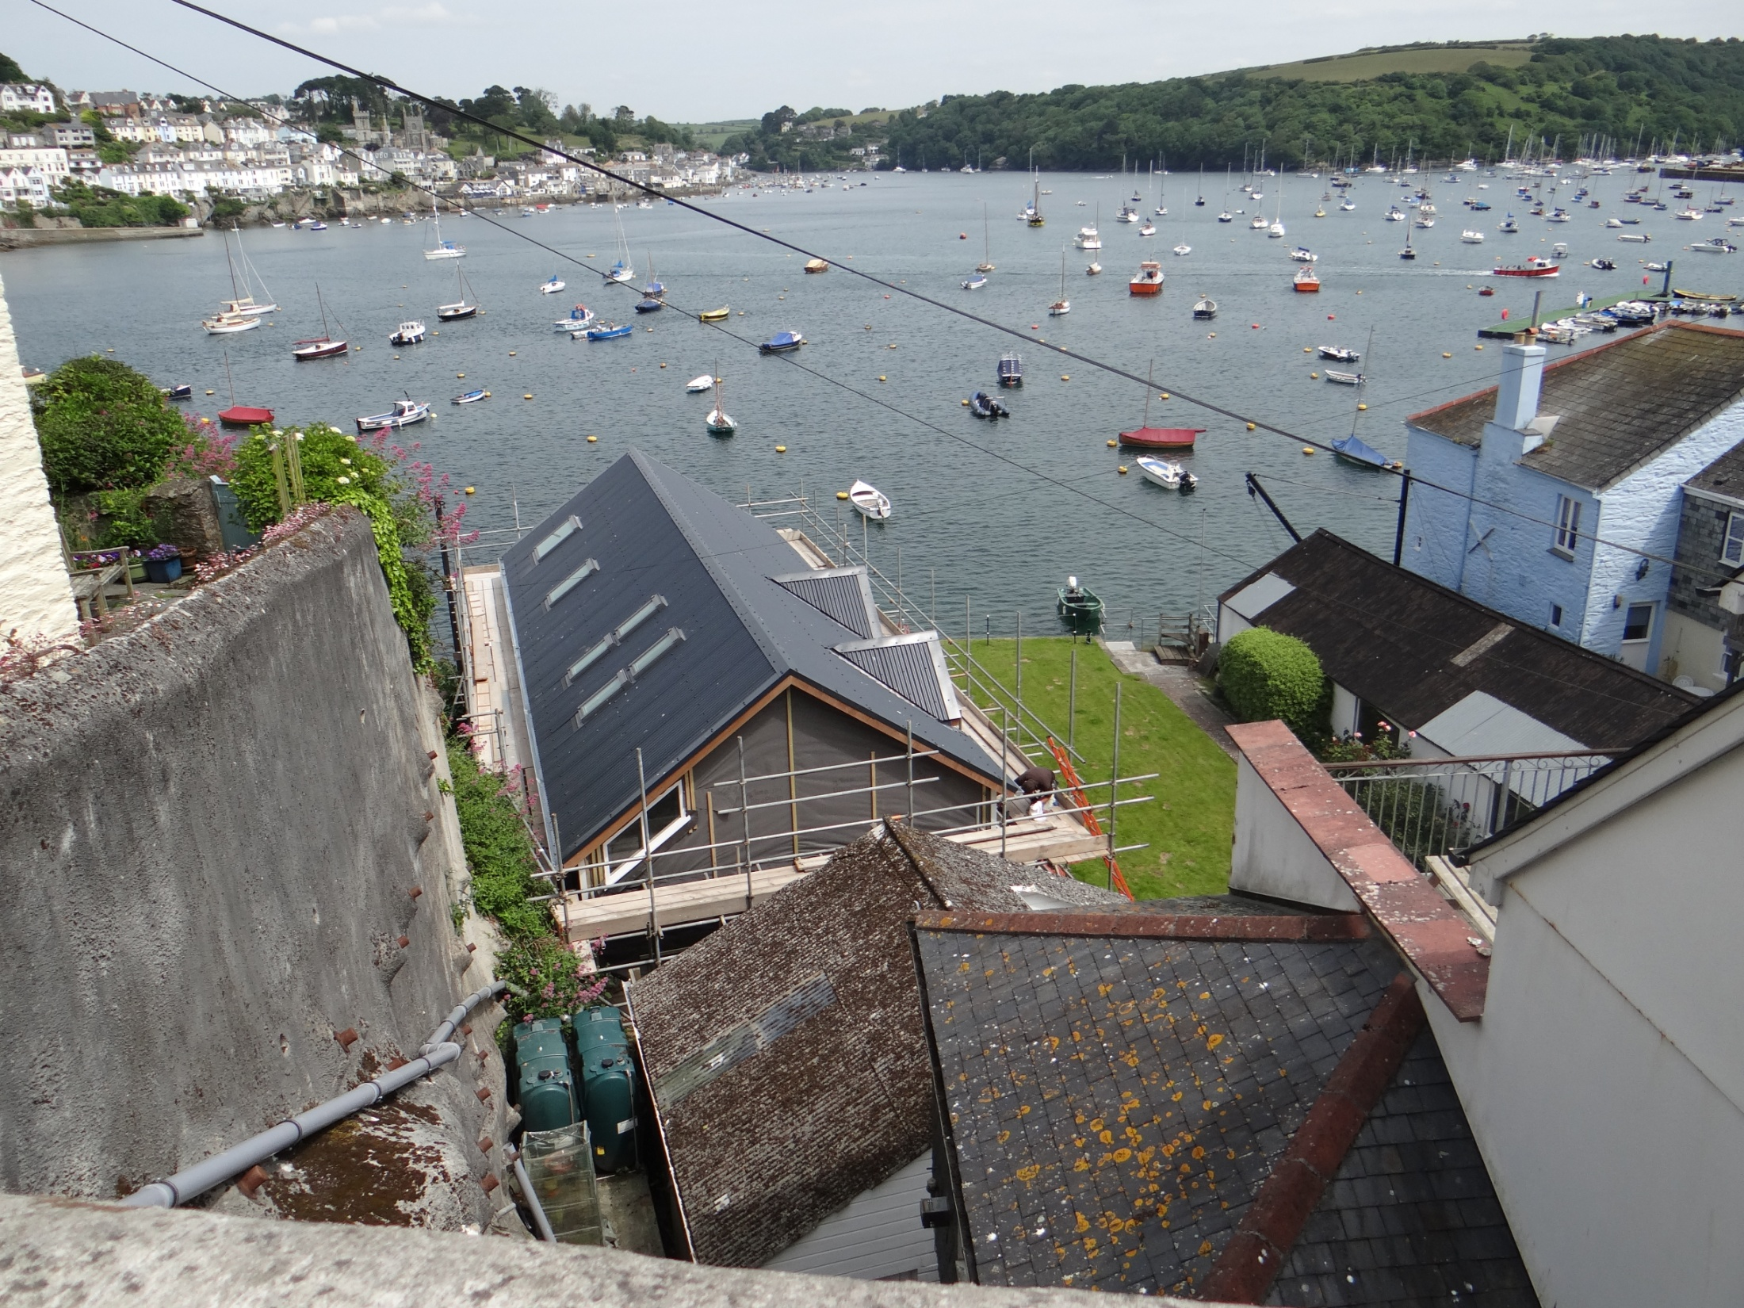

Slide 18
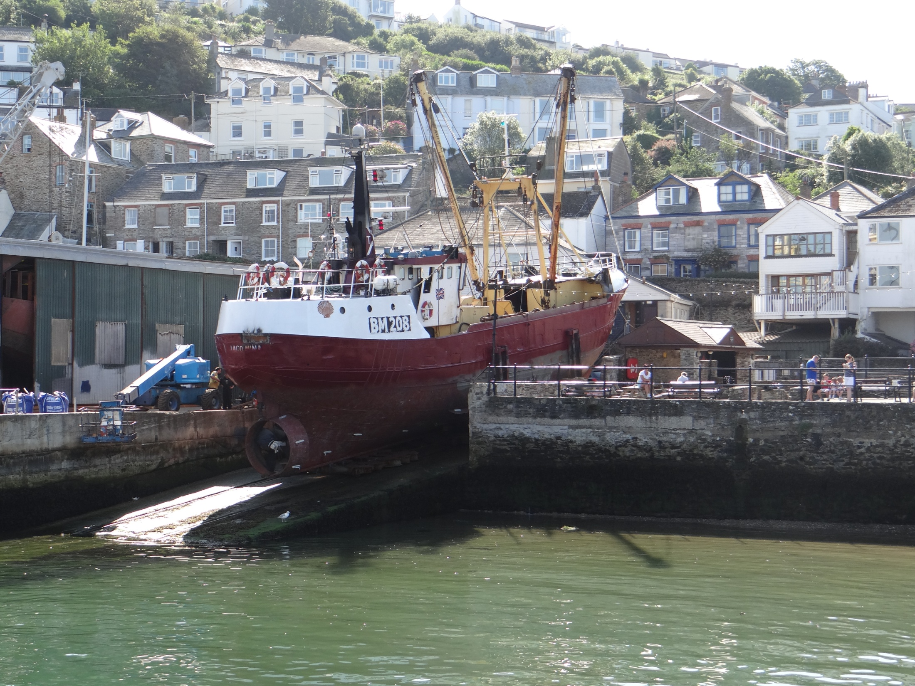

Slide 19
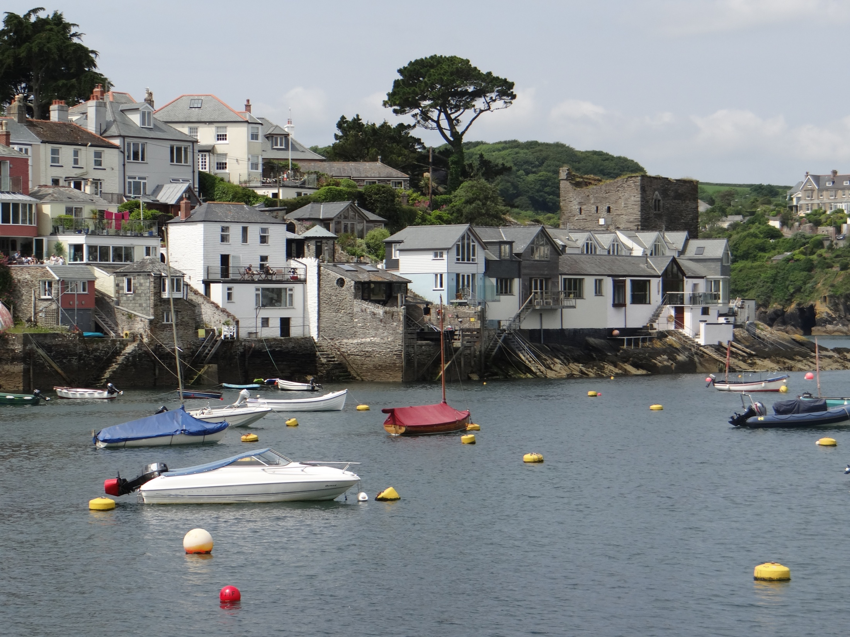

Slide 20
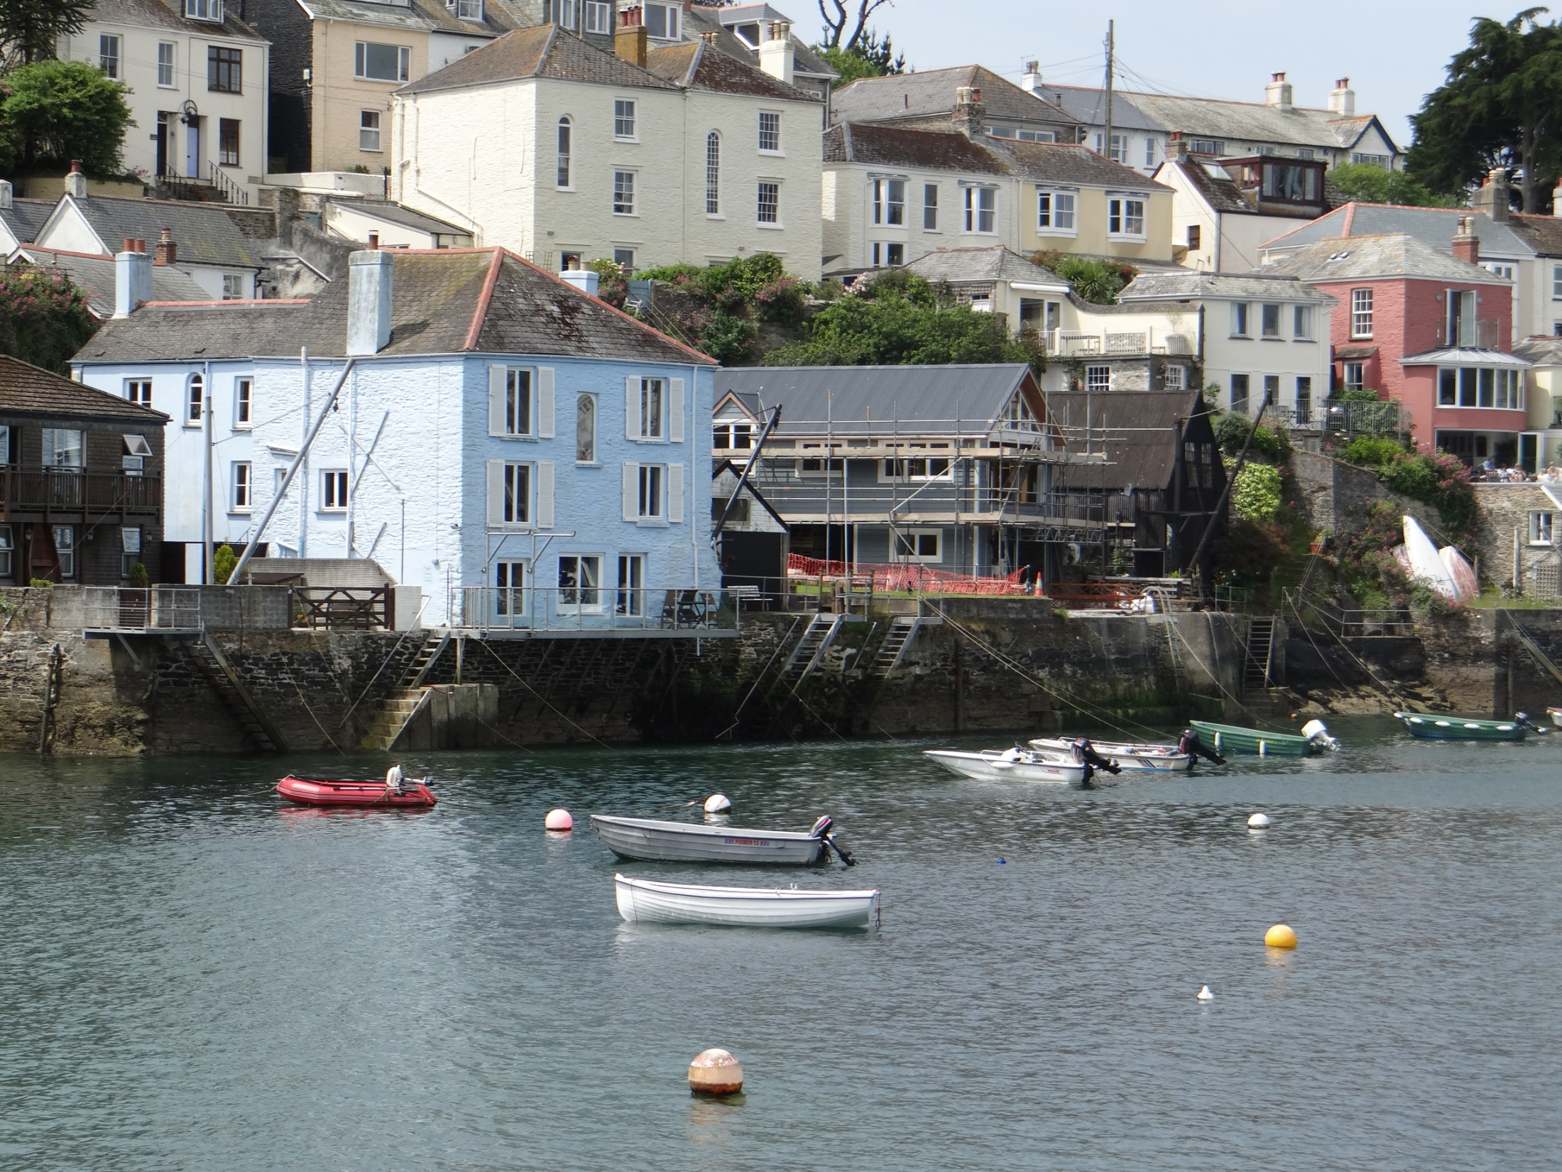

Slide 21
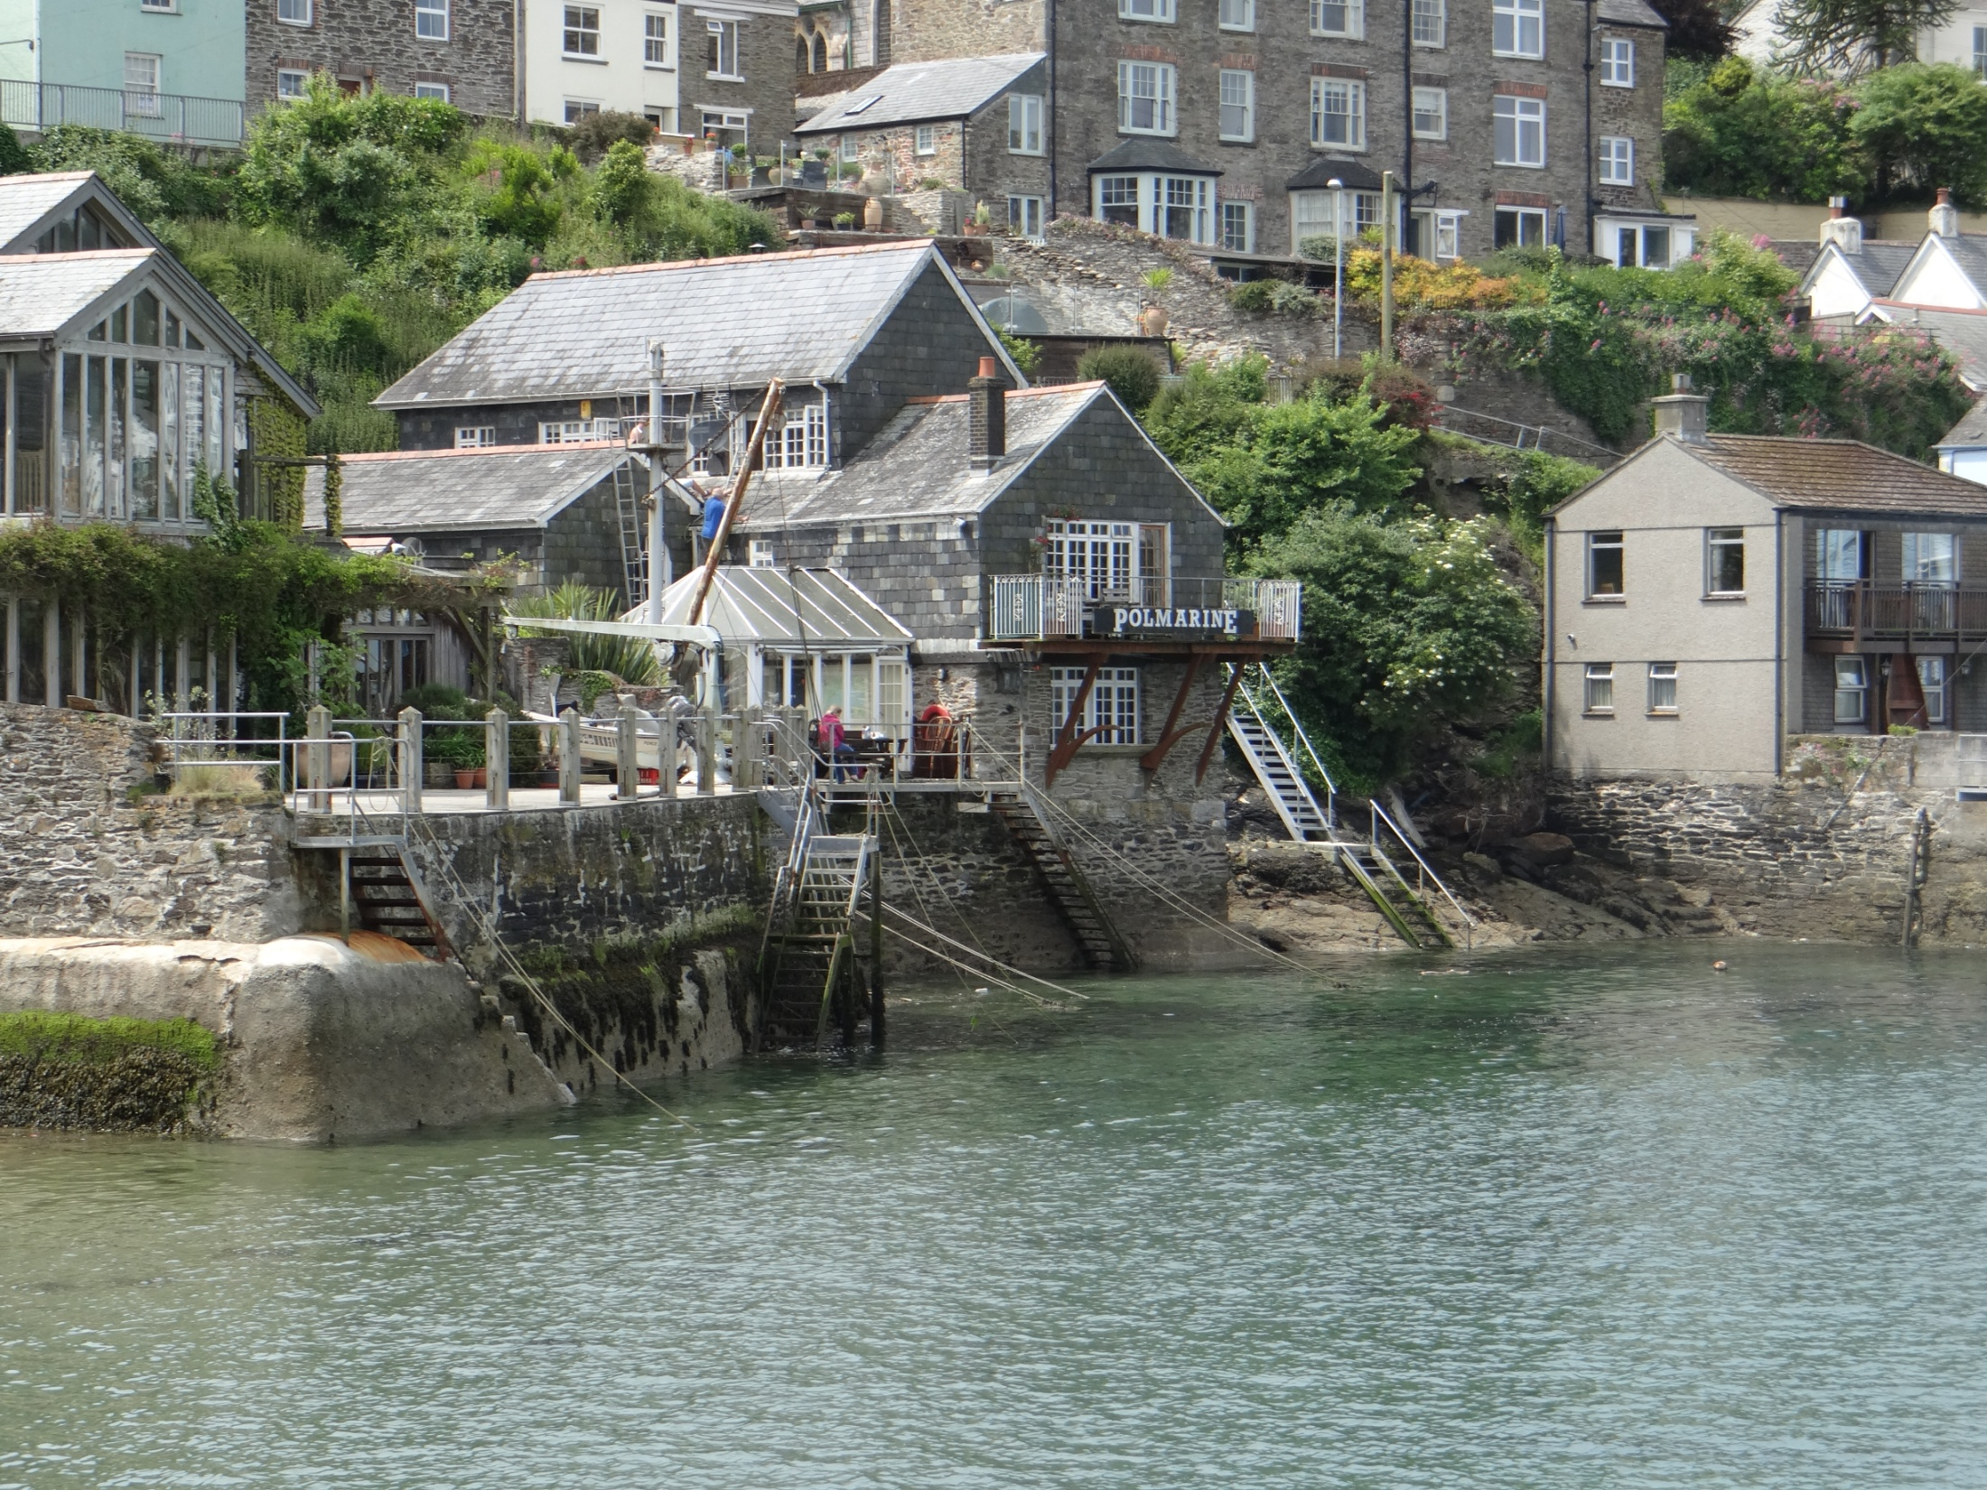

Slide 22
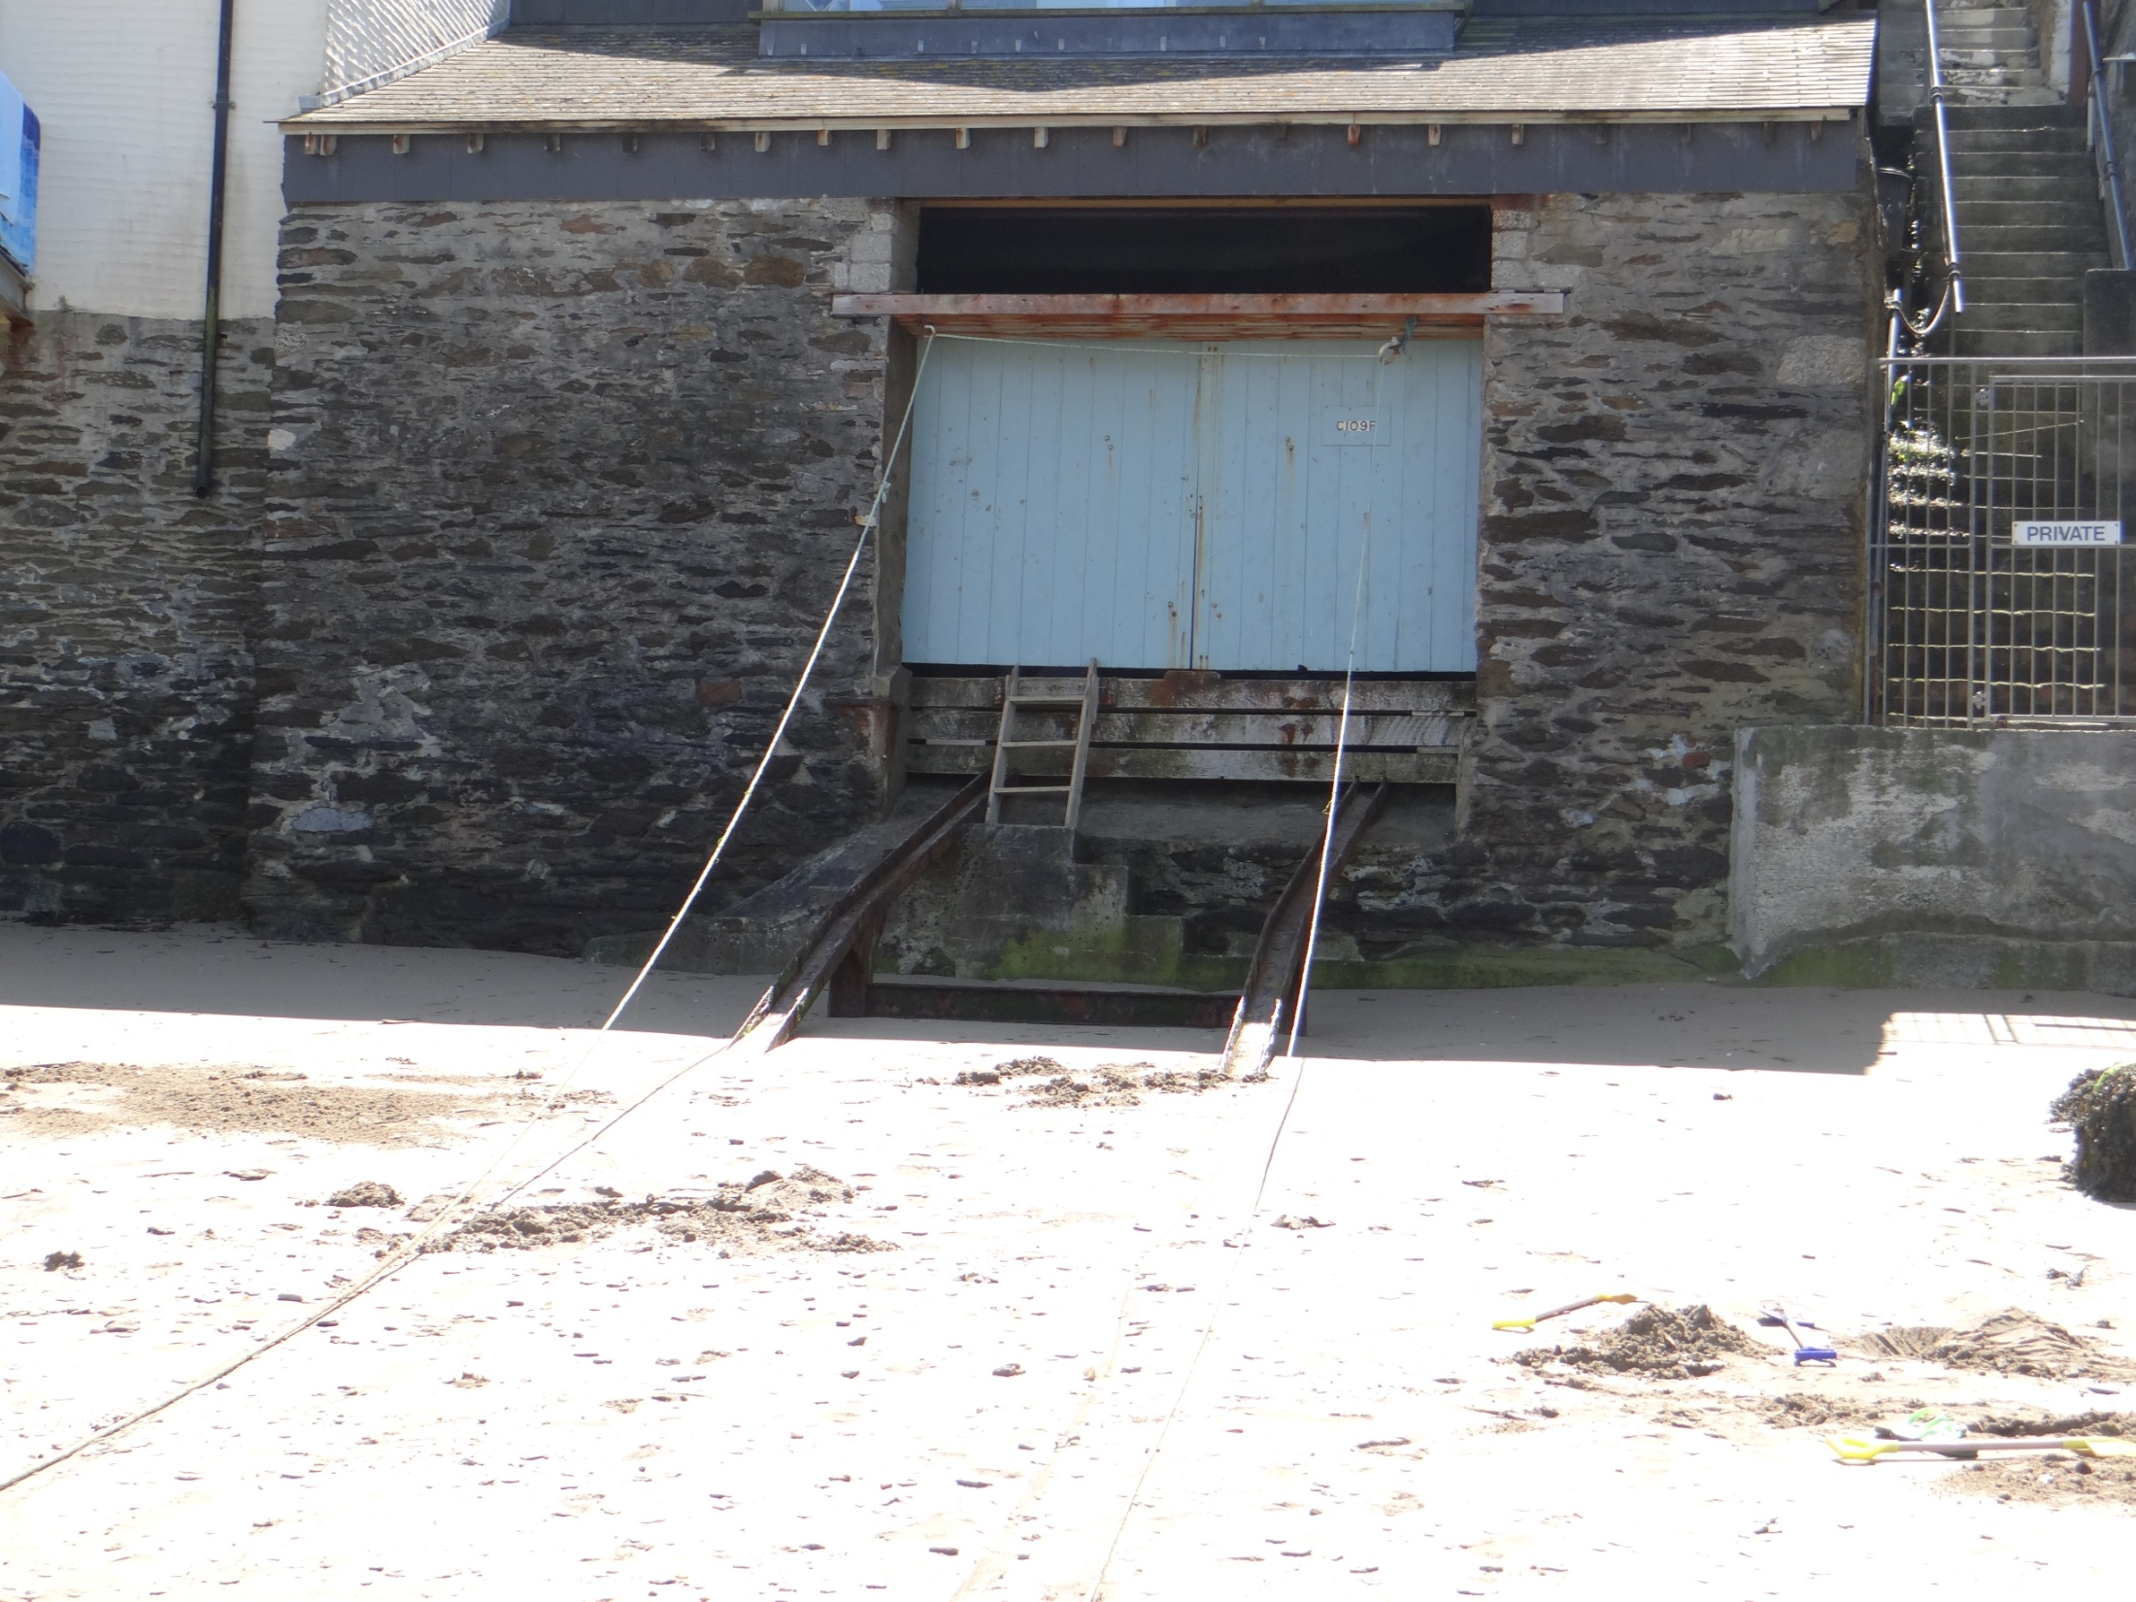

Slide 23
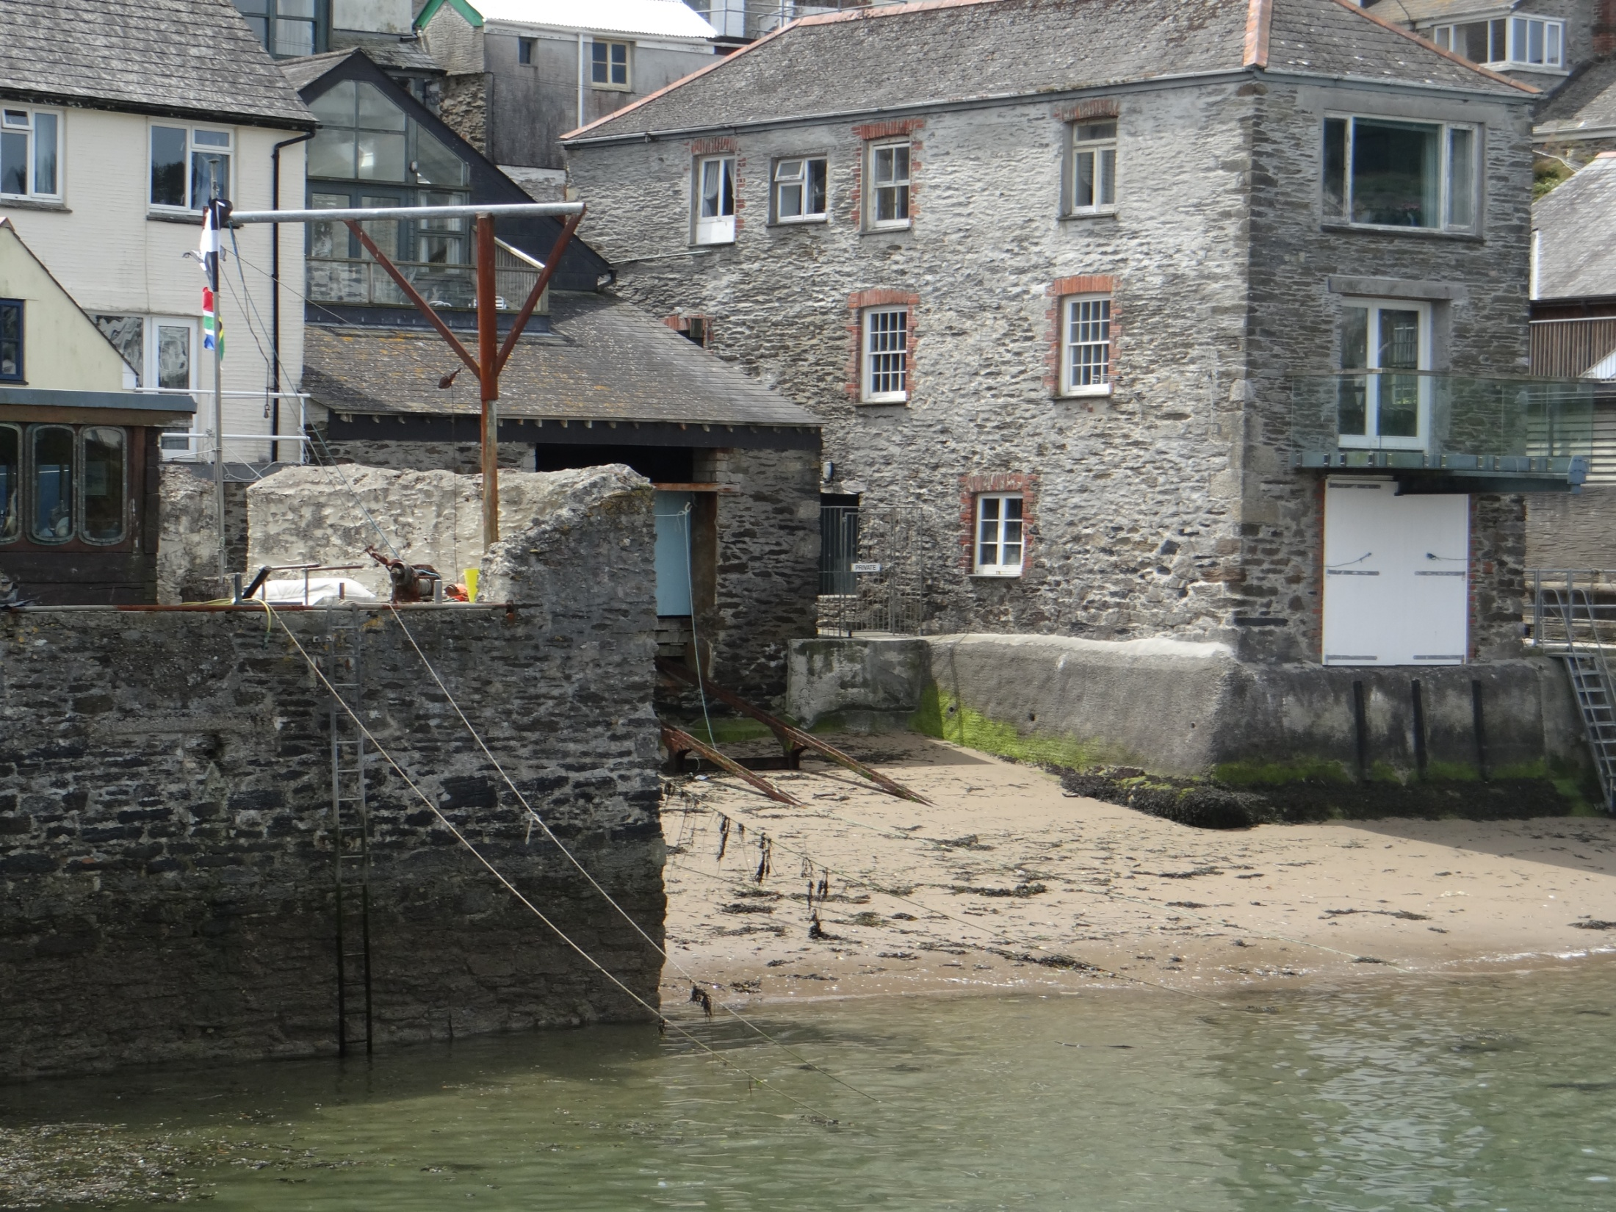

Slide 25
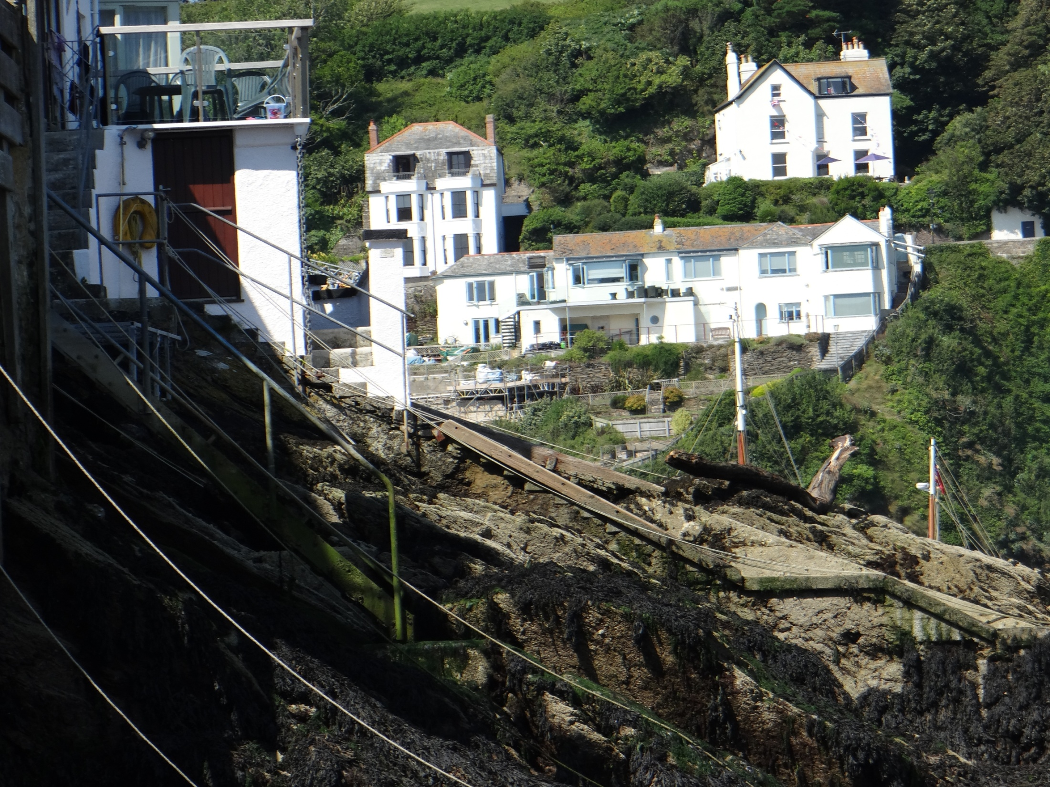

Slide 26
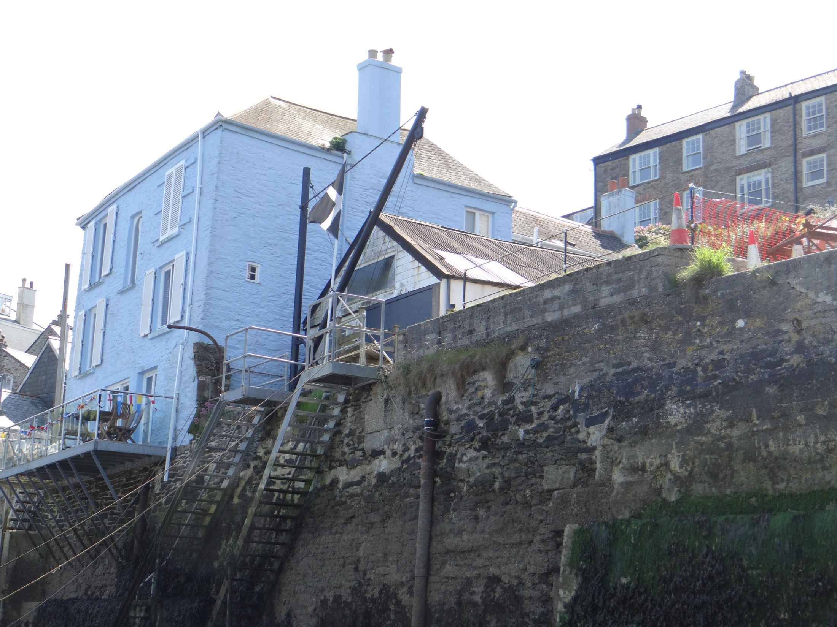

Slide 27
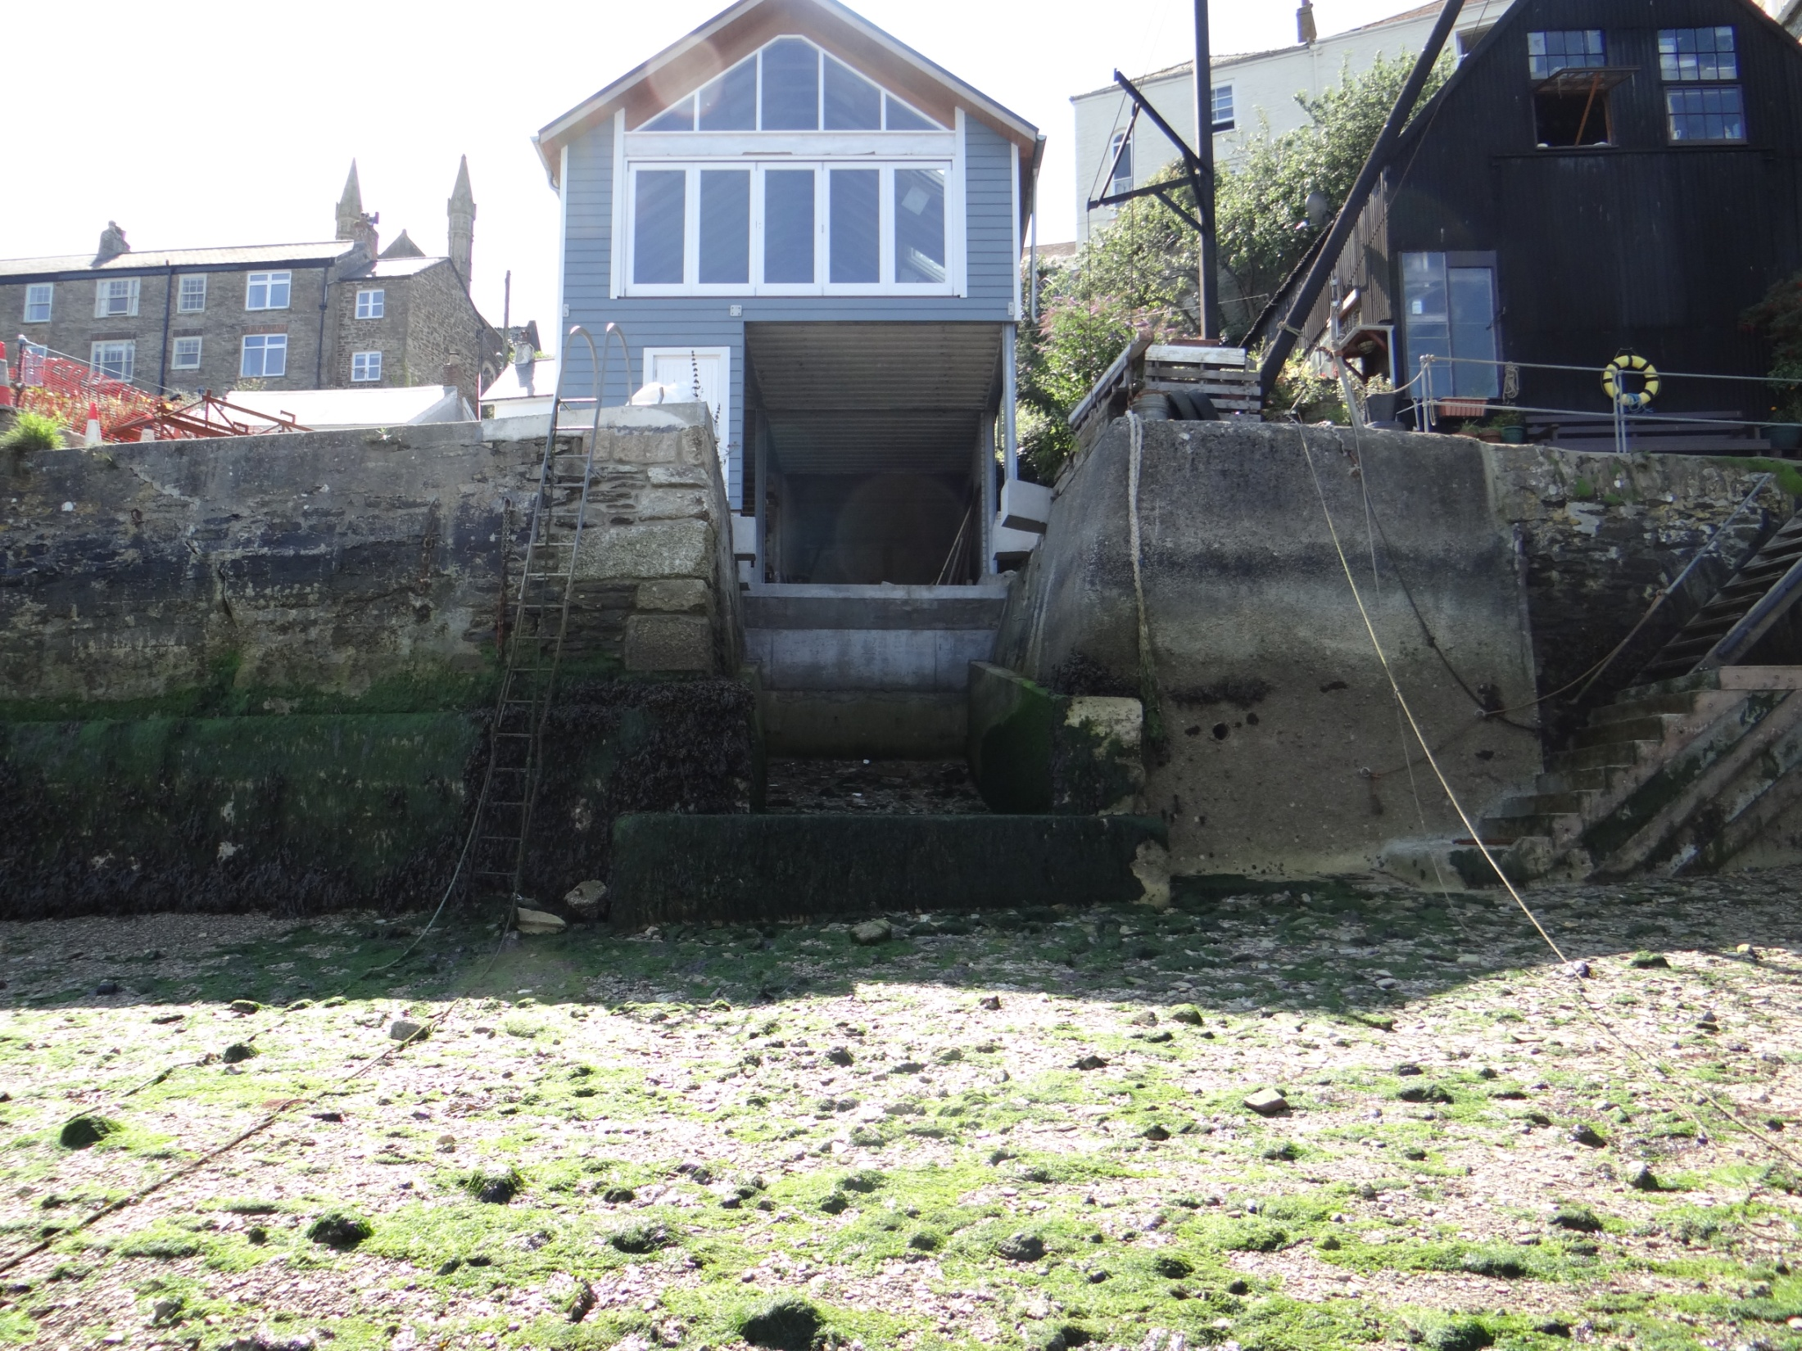

Slide 28
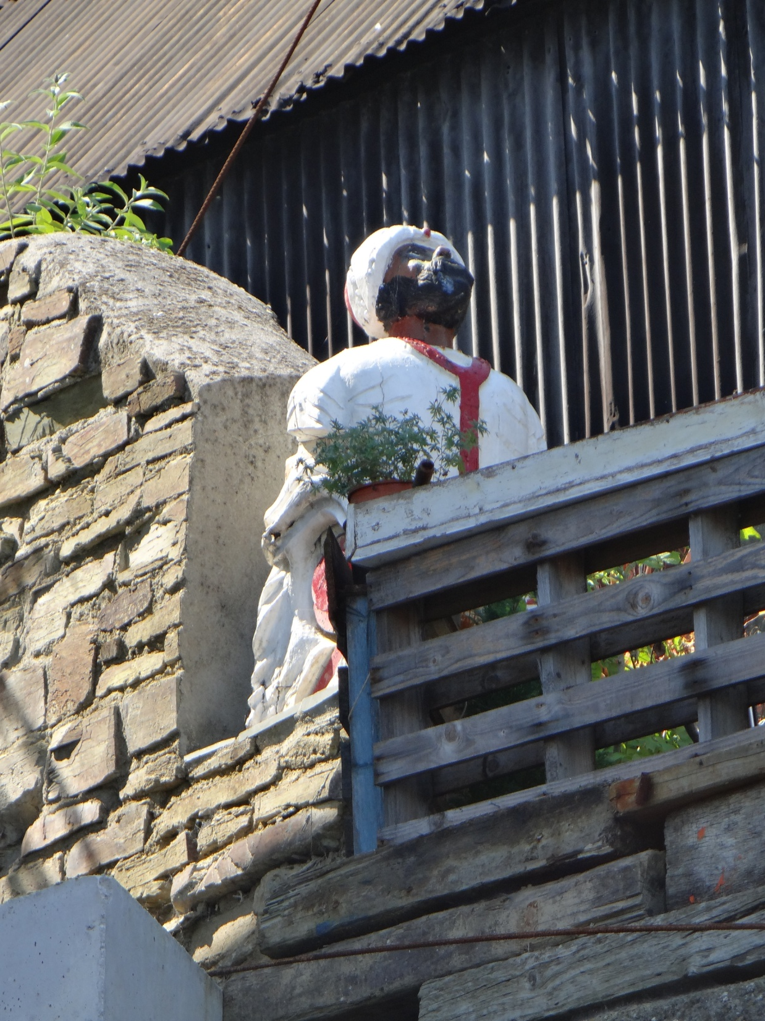

Slide 29
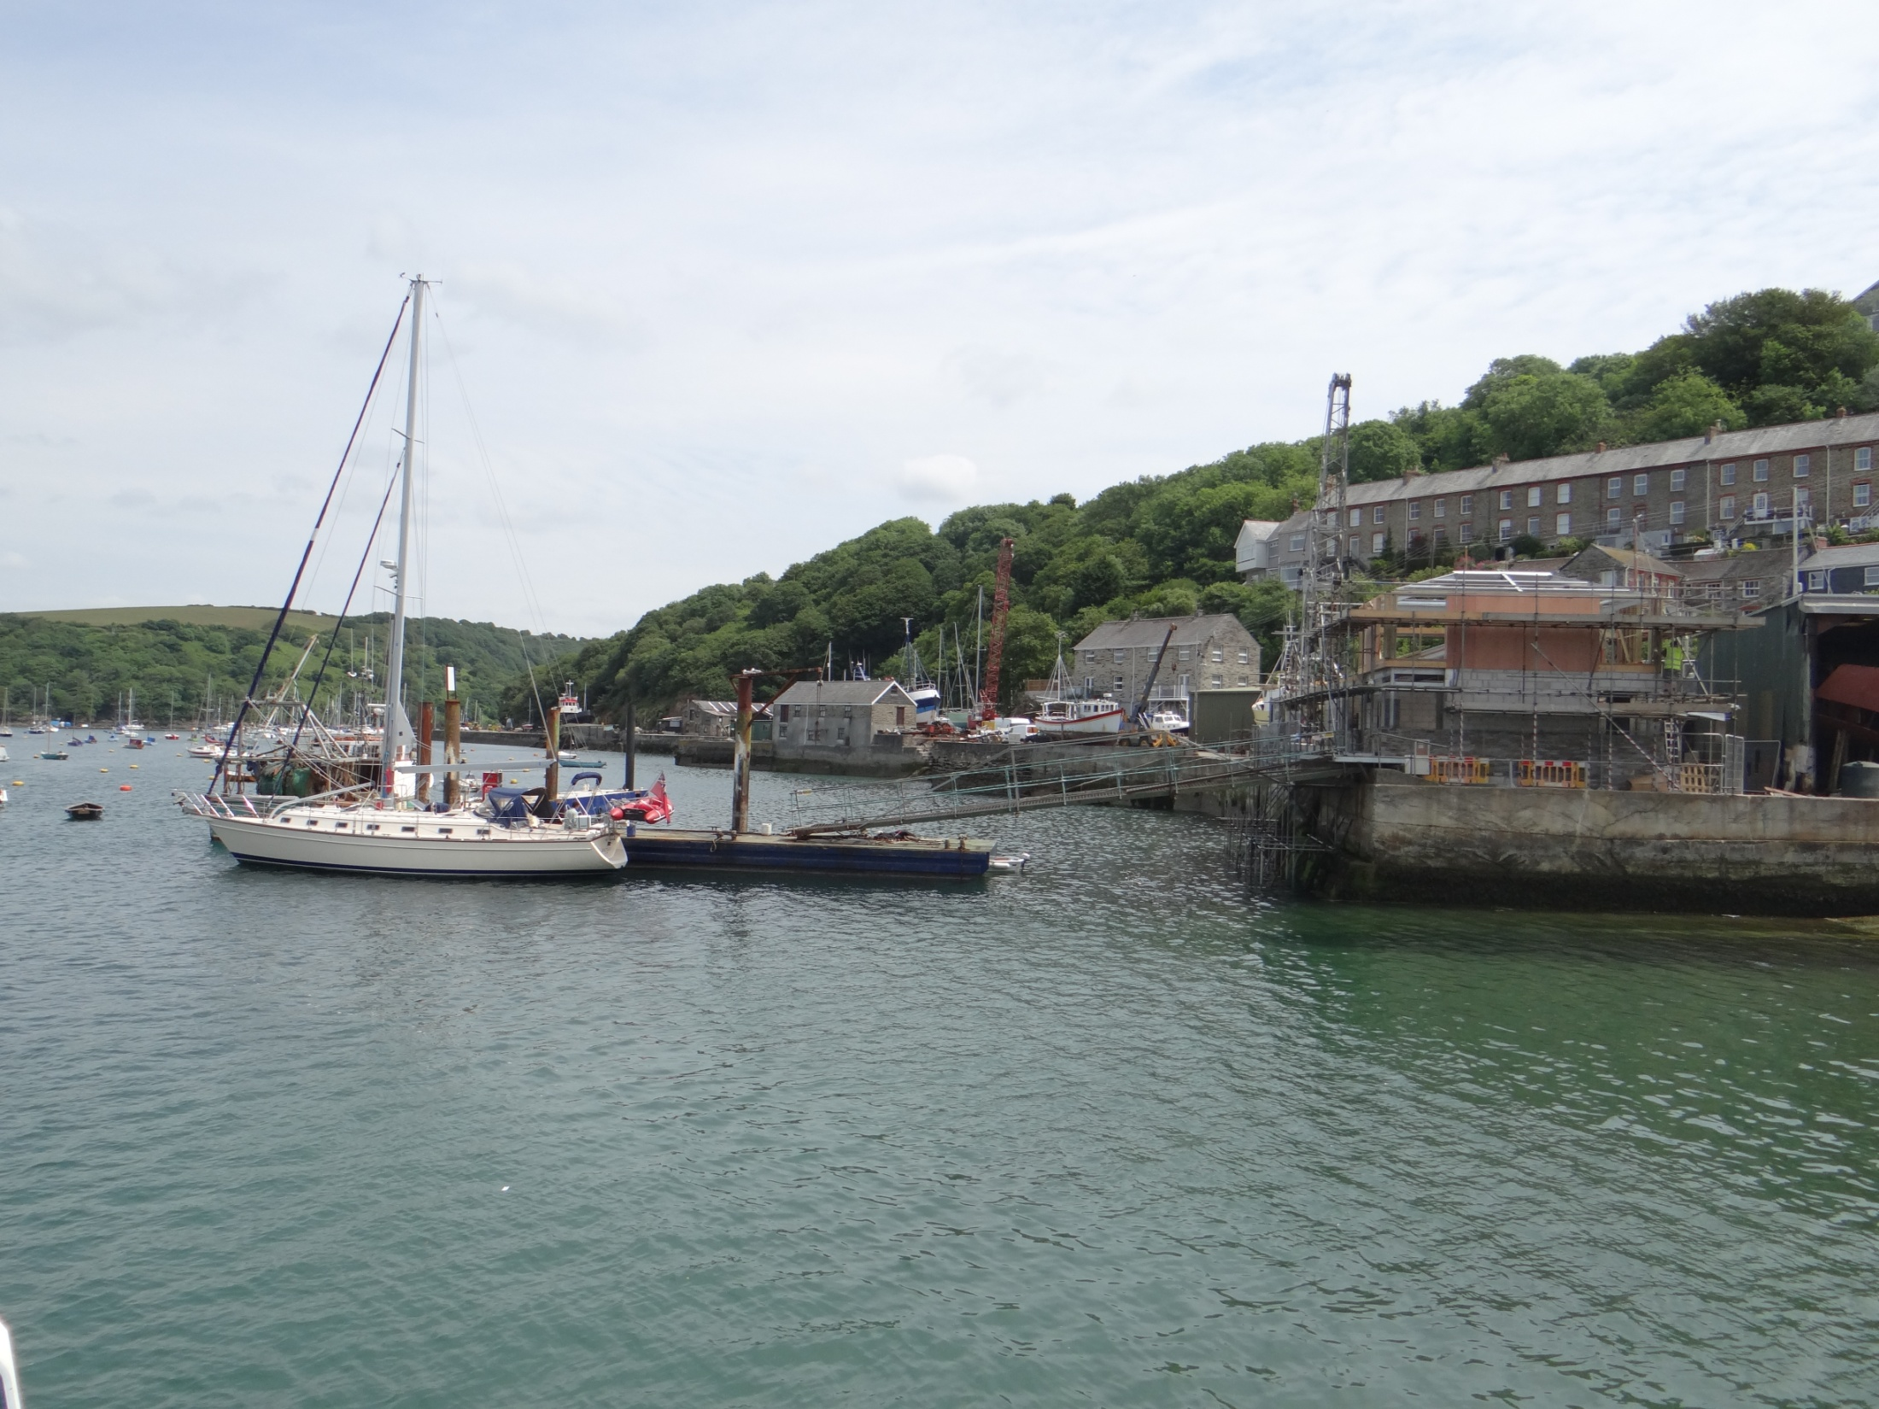

Slide 30
Monumental Inscriptions in the Churchyard of St Wyllow, Lanteglos-by-Fowey
289 – BUTSON, MARY EMMA, Our mother, wife of Nicholas, died 26 Mar 1905, aged 50
“The winter of trouble is past
The storms of affliction are oer
Her struggles are ended at last
And sorrow and death are no more”
NICHOLAS, her husband, died 30 Aug 1928,aged 78
360 – BUTSON, NICHOLAS J, died 14 Sep 1872 aged 54
JANE ANN, his daughter, died 26 Jan, 1885, aged 23
SUSAN, his wife, died 10 Mar 1895, aged 75
361 - BUTSON, NICHOLAS, late of Polruan died 18 Dec 1844, aged 65
ANN, died Oct, 1850, aged 69
362 – BUTSON, ELIZABETH WOON, wife of J.W.T. Of Polruan died 11 Sep 1851, aged 29
JOSEPH, W.T., her husband, died 22 Apr 1887, aged 65
363 – BUTSON, LAURA JANE, died 20 Aug, 1866, aged 2 (sic)
LAURA ELLERY, died 1 Oct 1866 age 6 (sic)
Note: LAURA ELLERY (BUTSON) was the daughter of LAURA JANE BUTSON. The gravestone is unclear, but other sources show the mother aged 23 and the daughter aged 6 weeks

Slide 31
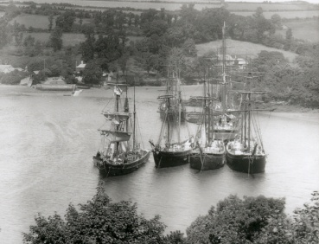

Slide 32
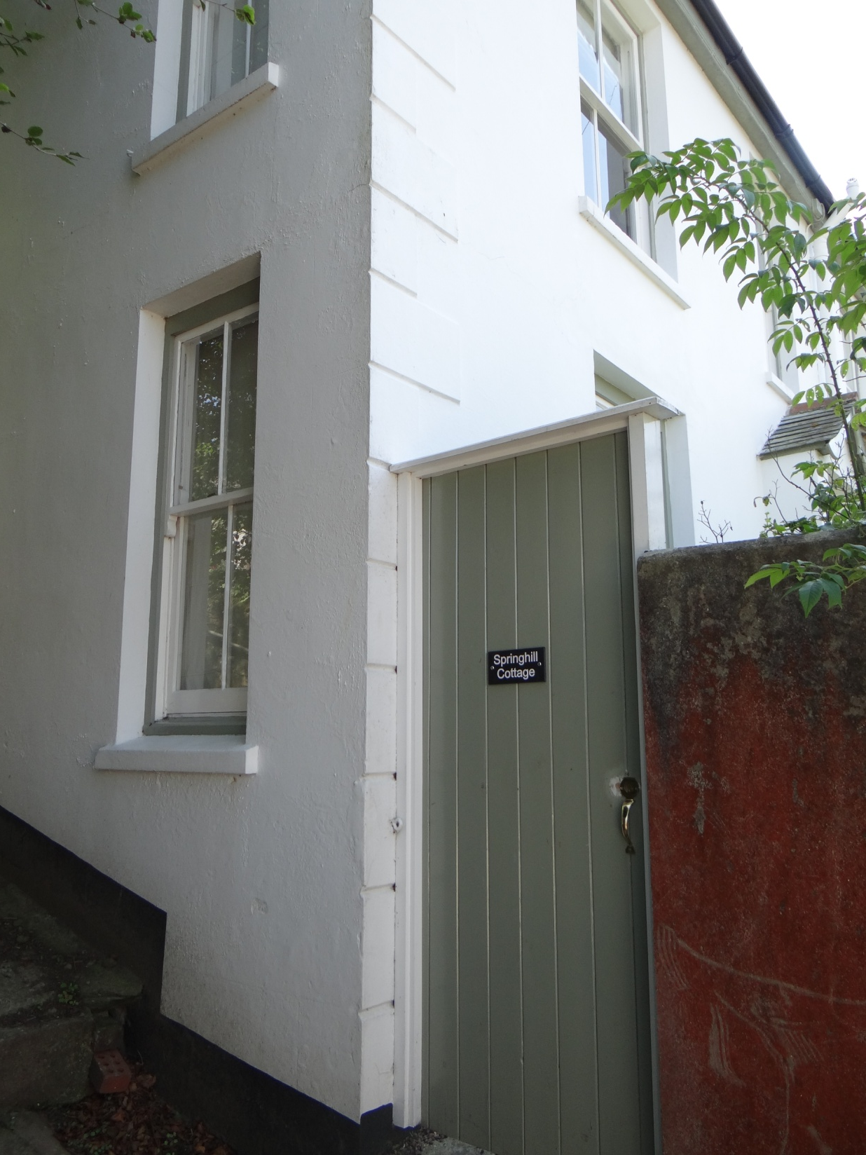

Slide 33
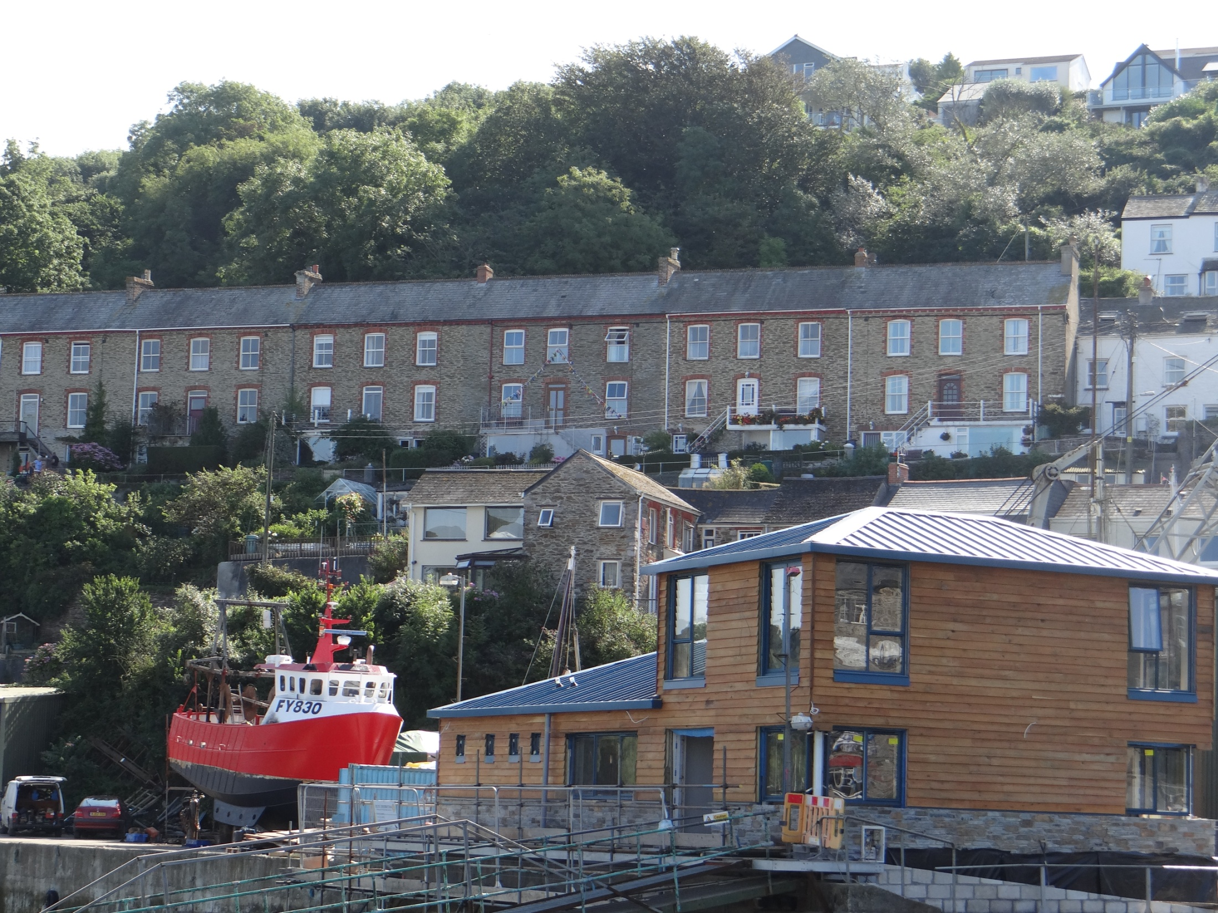

Slide 34
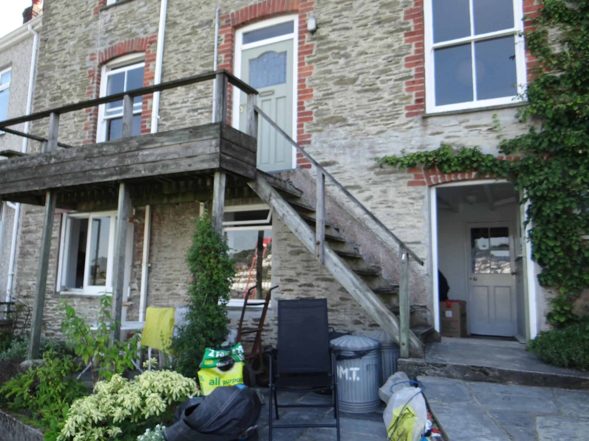

Slide 35
